Slide 1


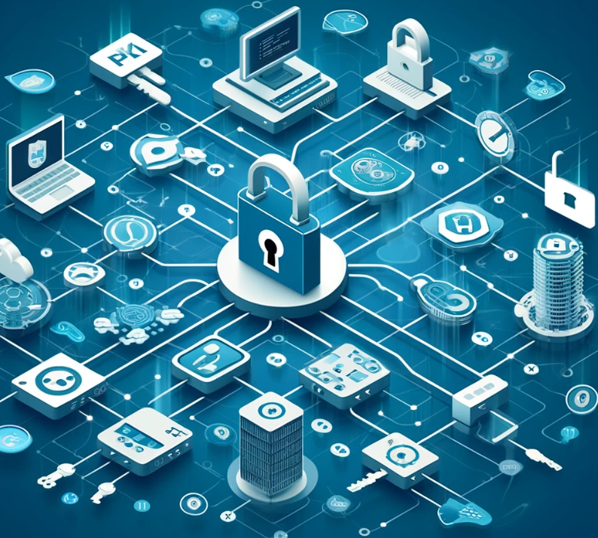


Top layer/text
Feb 14, 2024
Episode Details
Ziti Admin Console and Cert-based auth!
tv ‘noise’

Slide 2



Top layer/text
Jan 24, 2025
Episode Details
Didn’t DO IT
Office Hours and Working Session
tv ‘noise’

Slide 3


Top layer/text
Top layer/text
Dec 13, 2024
Jan 17 2025
Episode Details
Episode Details
Office Hours + This Week in Discourse
(two in one day?)
User Spotlight! Imperfektus!
tv ‘noise’
tv ‘noise’

Slide 4
Top layer/text
Jan 10, 2025
Episode Details
Windows and OIDC
tv ‘noise’

Slide 5
Top layer/text
Dec 13, 2024
Episode Details
Exploring OpenZiti + LiveKit + pion/webrtc
tv ‘noise’

Slide 6
Top layer/text
Oct 25, 2024
Episode Details
Working Session and Office Hours!
tv ‘noise’

Slide 7

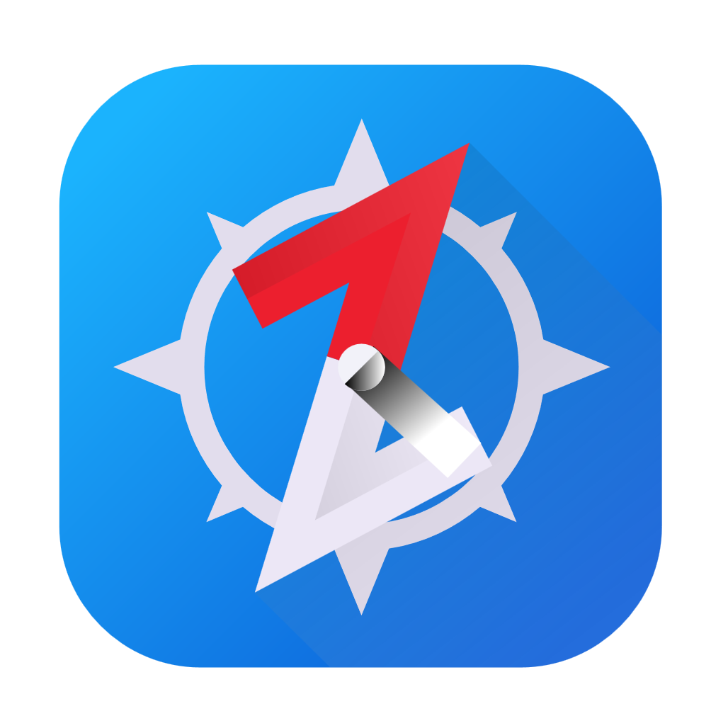
Top layer/text
Aug 30, 2024
Episode Details
BrowZer + ZAC Revisited
tv ‘noise’

Slide 8
Top layer/text
Aug 16, 2024
Episode Details
Let’s Build a Network
tv ‘noise’

Slide 9

Top layer/text
Aug 08, 2024
Episode Details
Demystifying zero trust!
tv ‘noise’

Slide 10
Top layer/text
Jul 12, 2024
Episode Details
Working Session and Office Hours!
tv ‘noise’

Slide 11

Top layer/text
Jun 14, 2024
Episode Details
OpenZiti, BrowZer, docker compose and self-signed PKI!
tv ‘noise’

Slide 12
Top layer/text
Jun 7, 2024
Episode Details
Exploring OpenZiti and Public Key Infrastructure (PKI)
tv ‘noise’

Slide 13
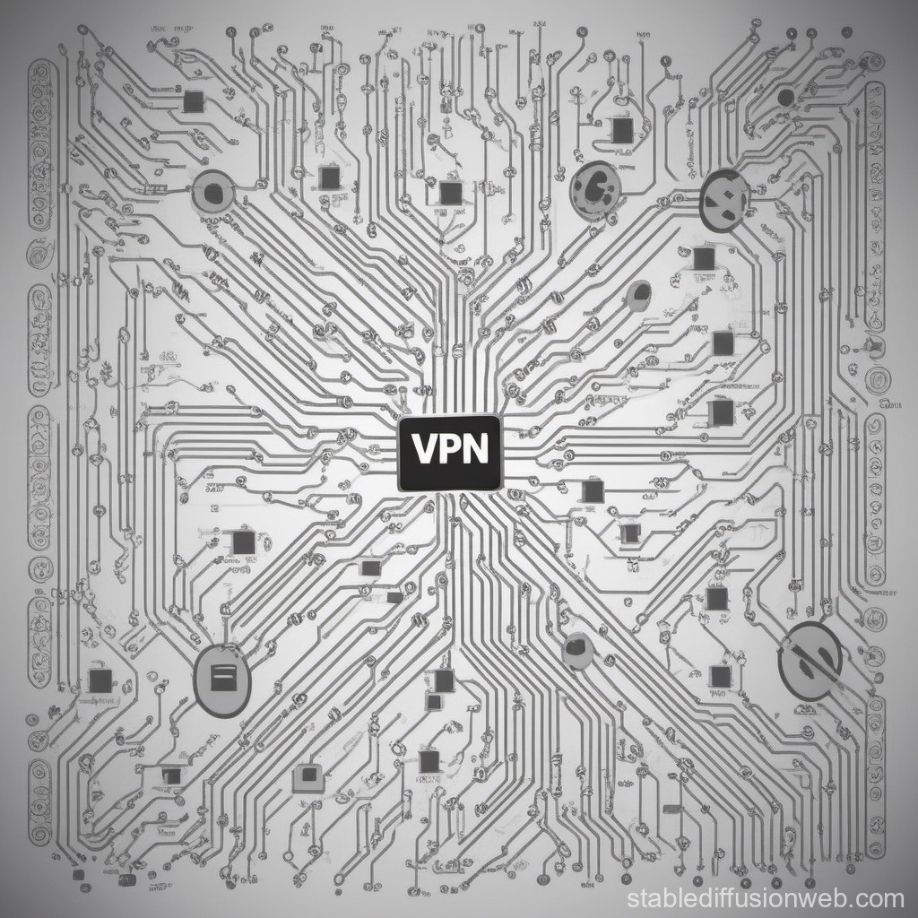

Top layer/text
May 10, 2024
Episode Details
zrok VPN
tv ‘noise’

Slide 14
Top layer/text
Apr 26, 2024
Episode Details
Building an Overlay
With Docker
tv ‘noise’

Slide 15
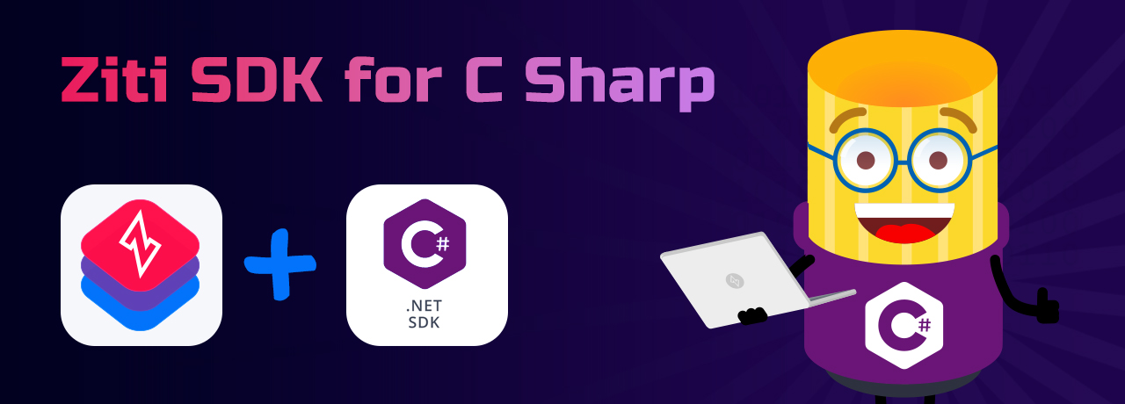
Top layer/text
Apr 19, 2024
Episode Details
Exploring the .NET SDK
tv ‘noise’

Slide 16
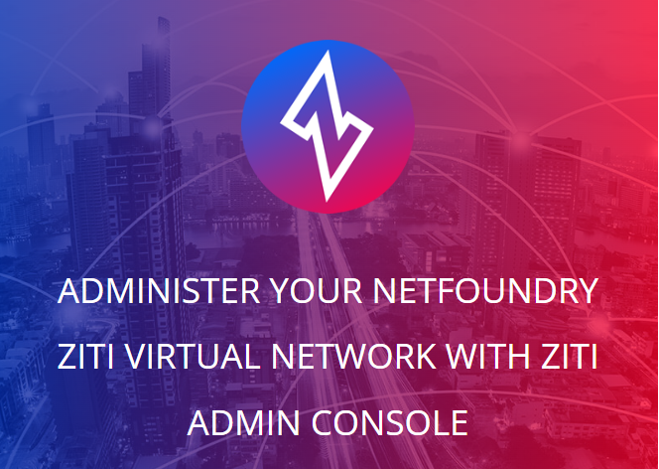
Top layer/text
Apr 11, 2024
Episode Details
OpenZiti – ZAC Primer
tv ‘noise’

Slide 17

Top layer/text
Mar 01, 2024
Episode Details
OpenZiti – step by step!
tv ‘noise’

Slide 18

Top layer/text
Jan 12, 2024
Episode Details
BrowZer + Keycloak!
tv ‘noise’

